Slide 1
A New World of Cloud Analytics
An Introduction to Google Earth Engine!
Hrishikesh Patel
Consulting Spatial Data Specialist
WORLD BANK
Wednesday, April 29 | 11:00-12:00 am

Slide 2
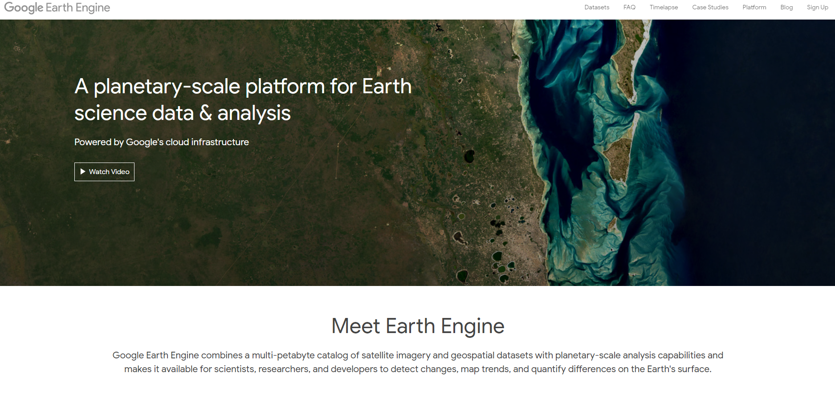
What is Google Earth Engine ?

Slide 3
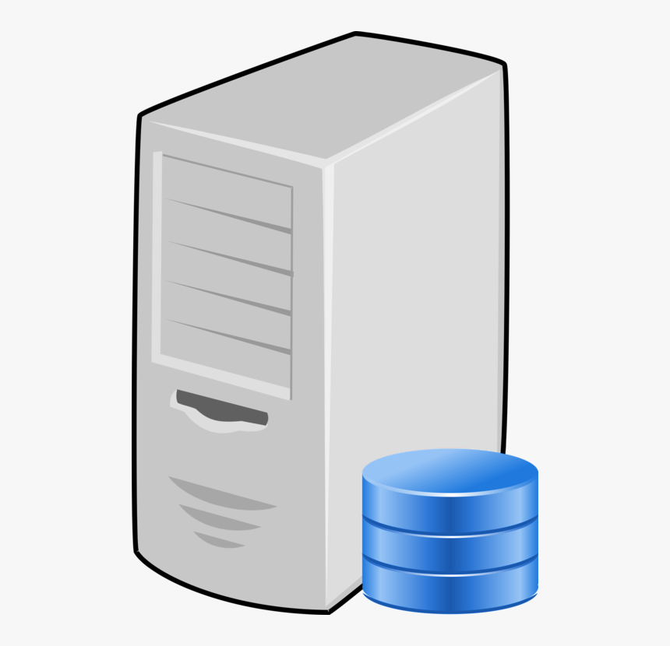
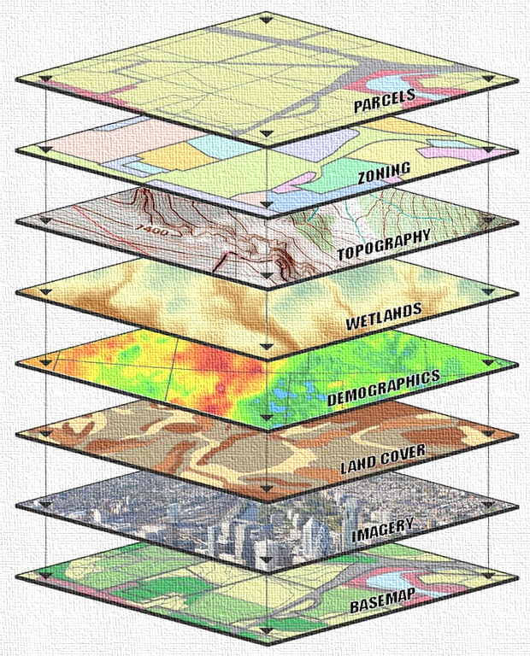
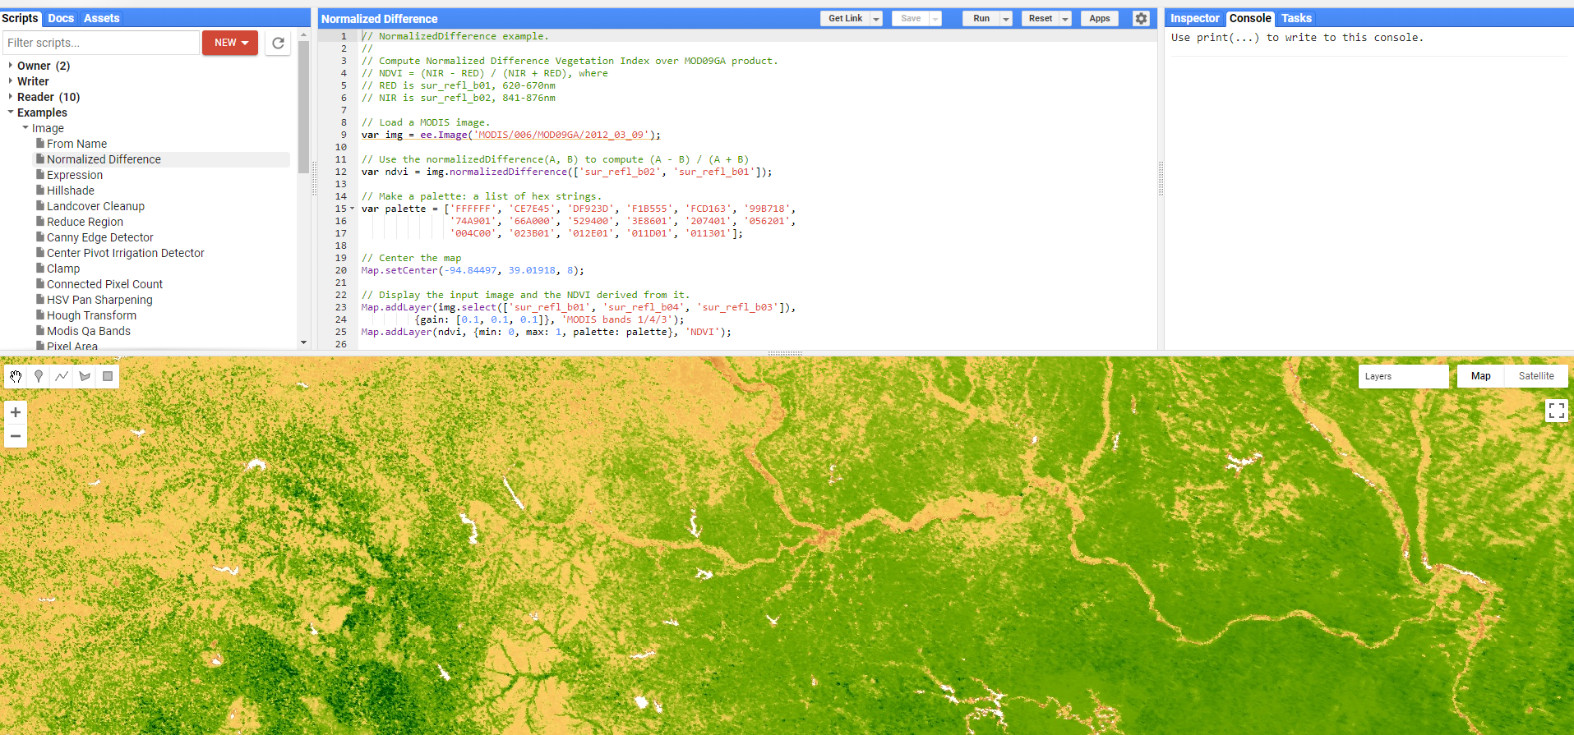
What is Google Earth Engine ?
Google Earth Engine is a powerful variant of desktop or server based Remote Sensing and GIS functionality.
Google Earth Engine allows cloud-based geospatial analytics.
Google Earth Engine supports JavaScript (command line) and Python (suited for applications development) APIs or Application Programming Interfaces.
GEE is very powerful framework for raster processing but relevant for several vector related tasks. It provides a framework, you still need to provide modeling processes (supervised classification, principal components etc.)

Slide 4
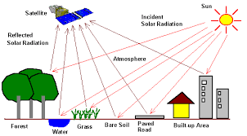
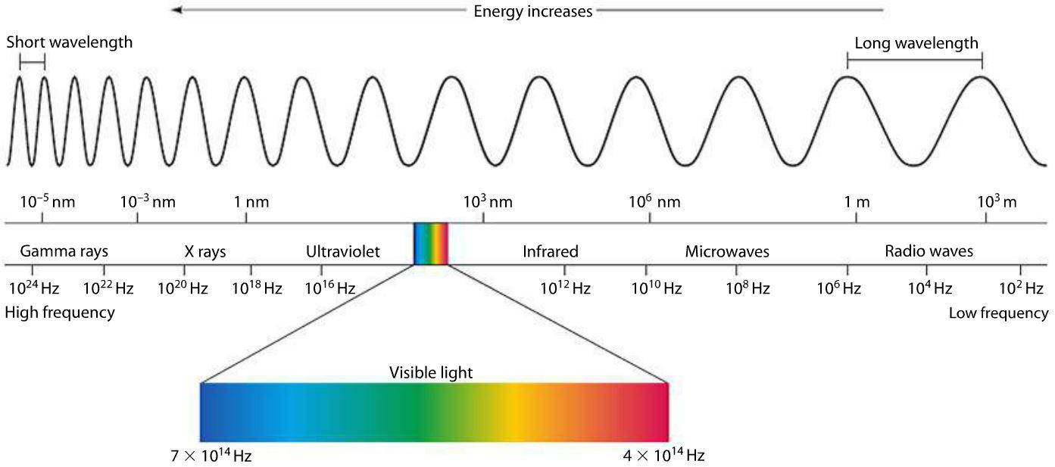
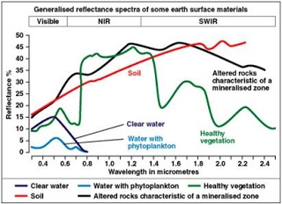
Remote Sensing: One Minute Preview !!
Every object on ground has a unique reflectance pattern throughout the electromagnetic spectrum.
This difference, when applied through mathematical algorithms, ratios, and other statistical techniques can differentiate between forests, land, water, crop etc.

Slide 5
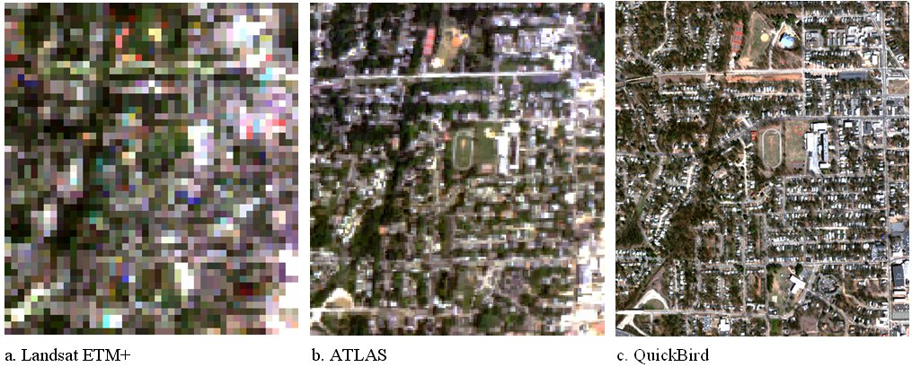
Spatial Resolution
Imagery are often available in different resolutions. MODIS data can vary from 250m to 1km per pixel, while Landsat data are 30m, while Sentinel 1 and 2 data are 10 to 20m per pixel.
There is a trade off between frequency of collecting data and resolution of the satellite or sensor.

Slide 6
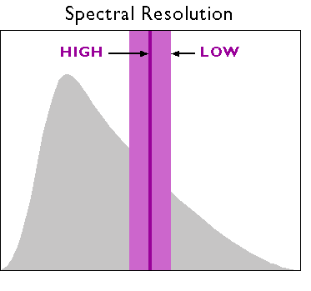
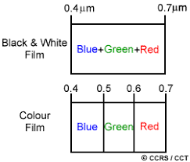
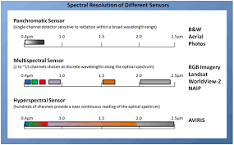
Spectral Resolution
The wavelength of the different frequency bands recorded – usually, this is related to the number of frequency bands recorded by the platform. Landsat and MODIS, while Hyperion has 220 bands from.

Slide 7
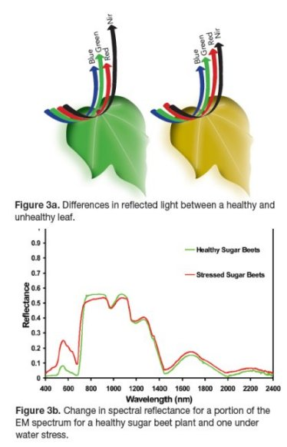
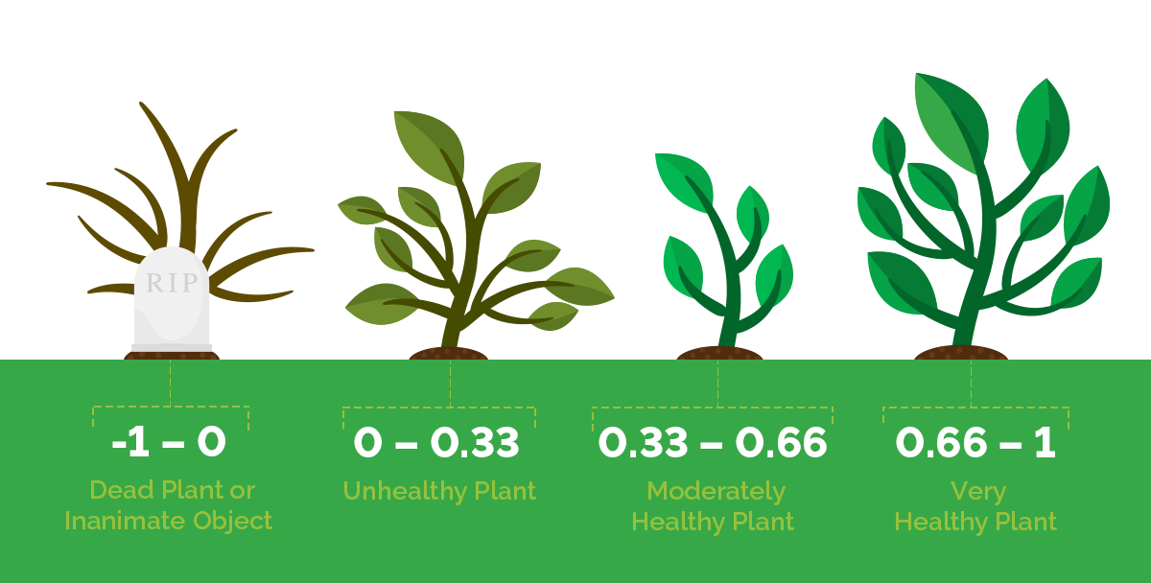
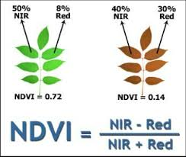
Simple Indices: e.g. Normalized Difference Vegetation Index
Similar indices exist for monitoring water (wetness), built-up area etc.

Slide 8
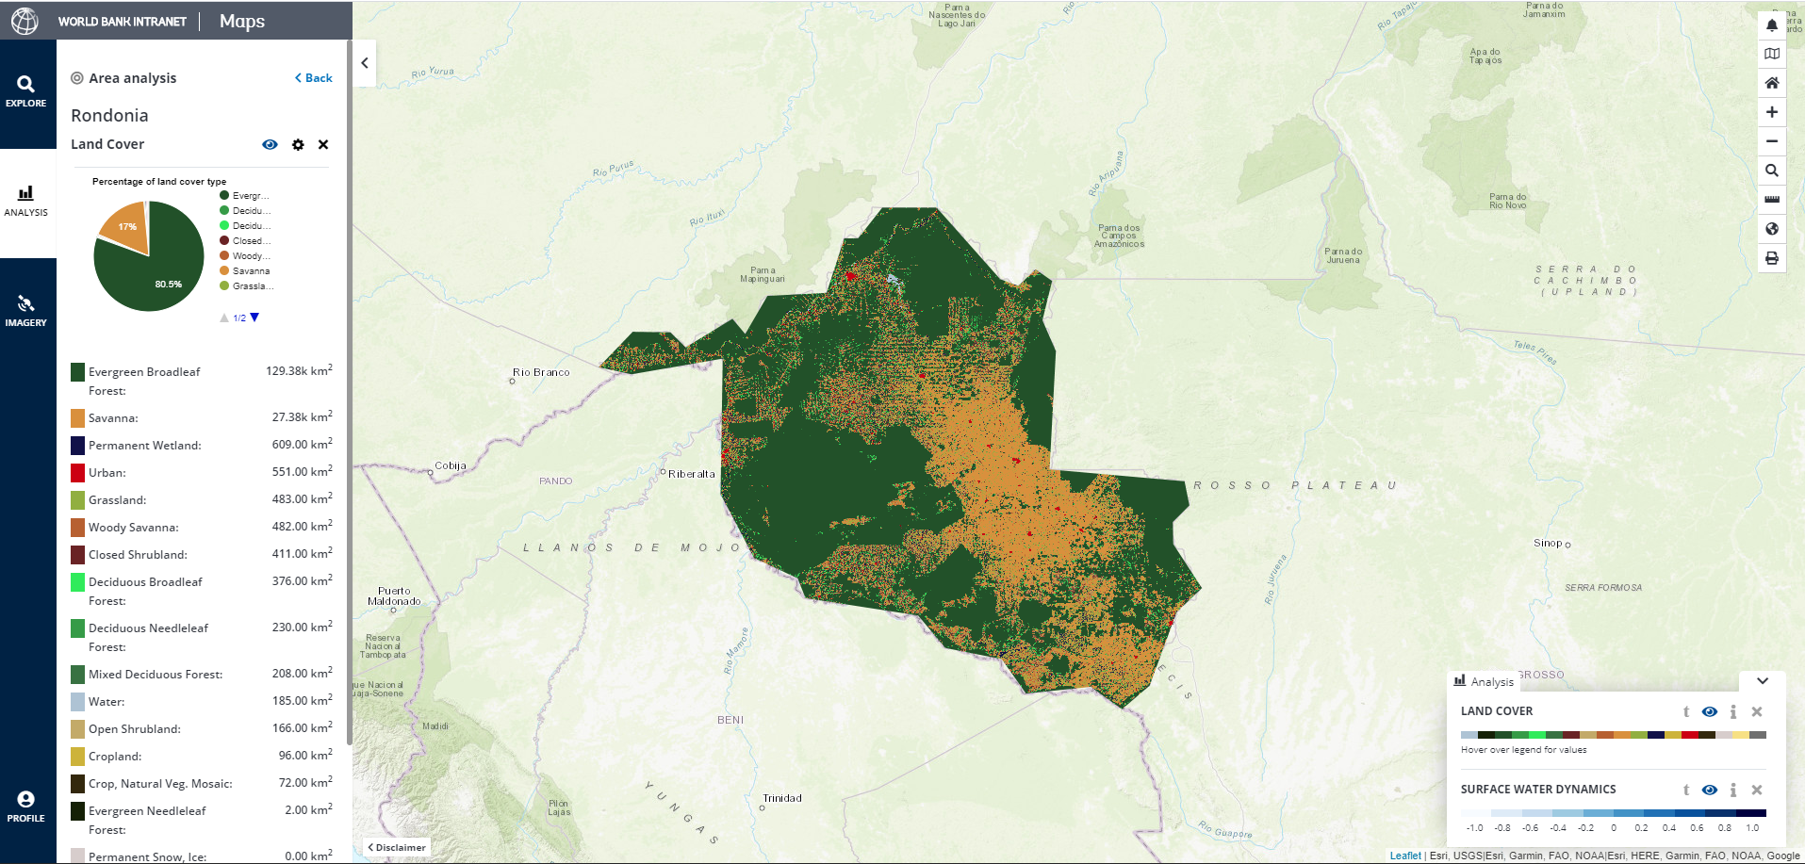
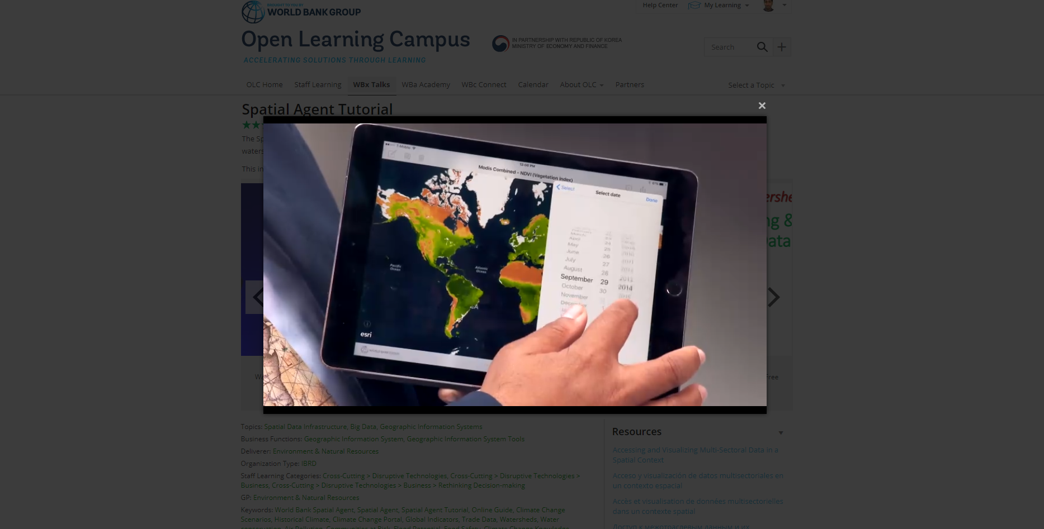
Applications
Existing and Potential Applications include (including Major Applications):
Mapping Forest Cover Change
Surface Water Dynamics
Flood extent and comparison
Generating Drought Indices
Biodiversity Mapping
Mapping Malaria Risks
Mapping Mangroves
Crop Types and Crop Productivity
Reservoir Area Dynamics
Long and Short-Term Climate (Temperature, Precipitation, Evapotranspiration Trends)
Air Quality …

Slide 9
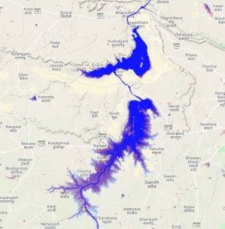
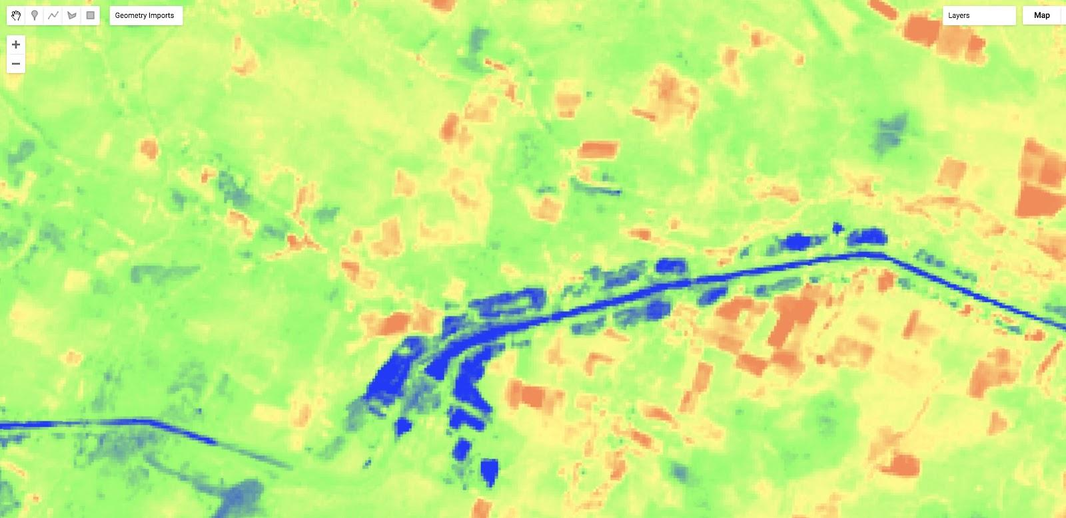
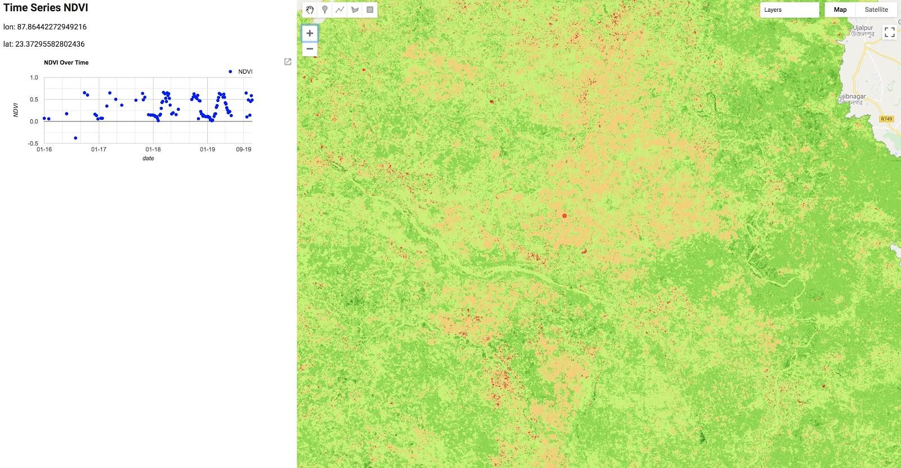
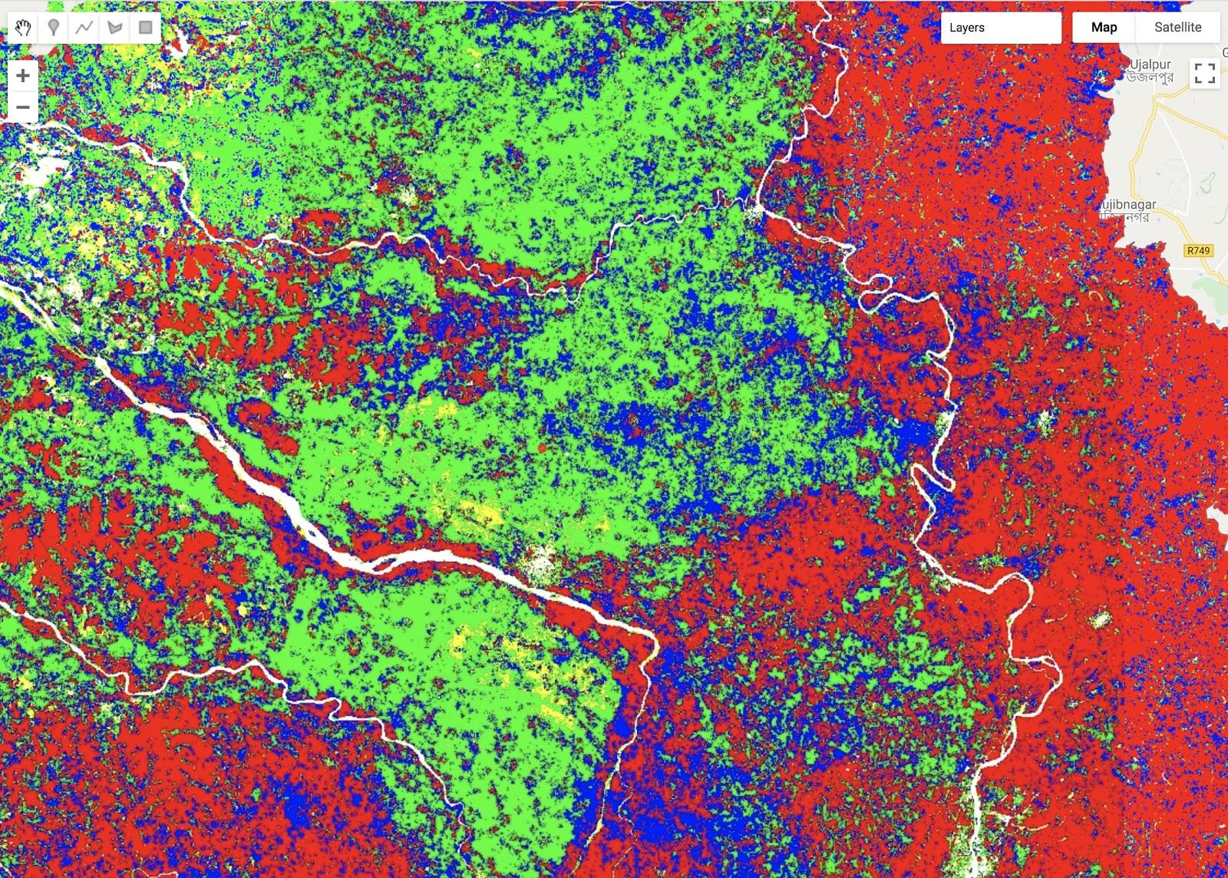
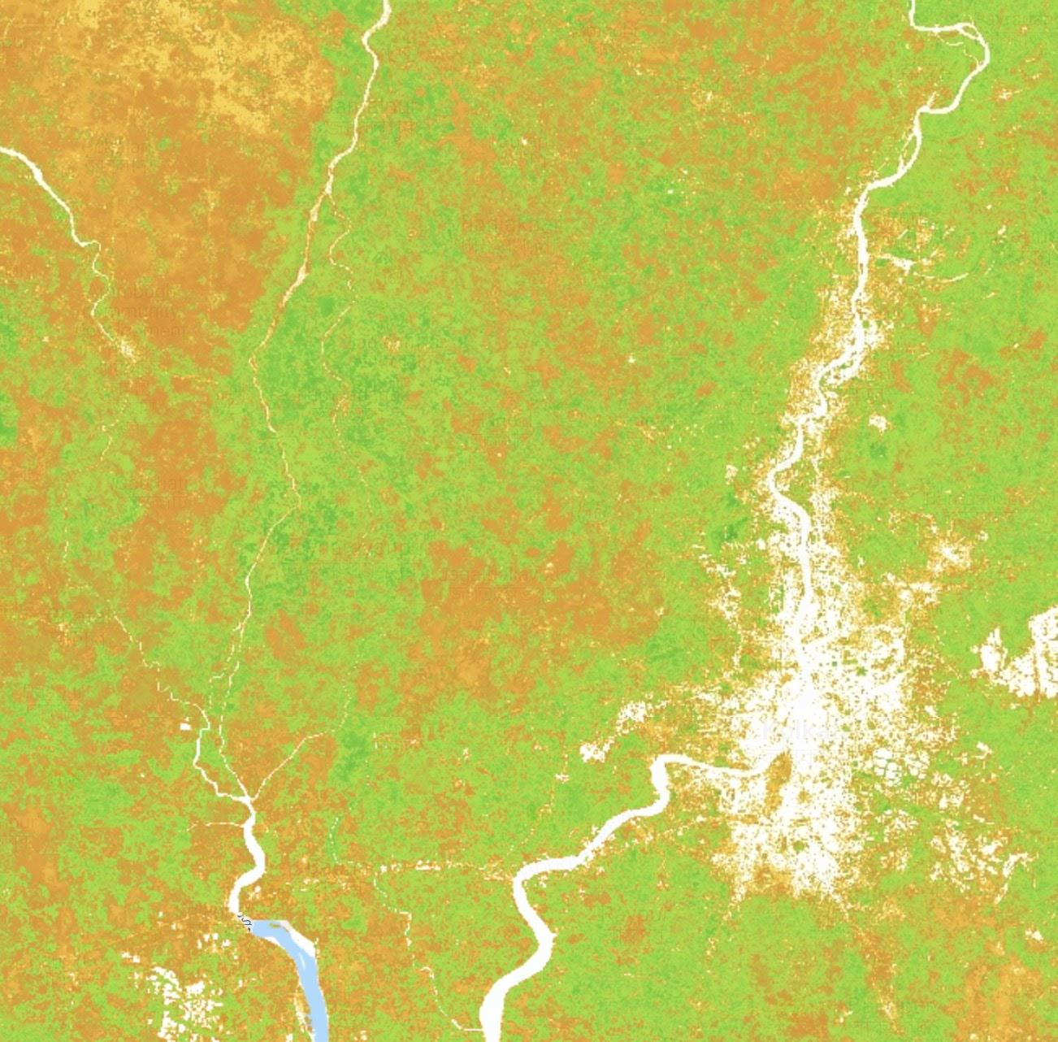
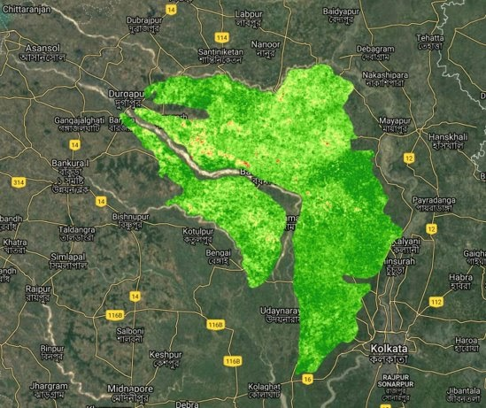
Custom Applications
Reservoir Dynamics, Flooding and Cropping Metrics in India (West Bengal, Gujarat, Kerala)
Reservoir Dynamics
Vegetation Moisture
Change in Cropping
Cropping Intensity and Changes

Slide 10
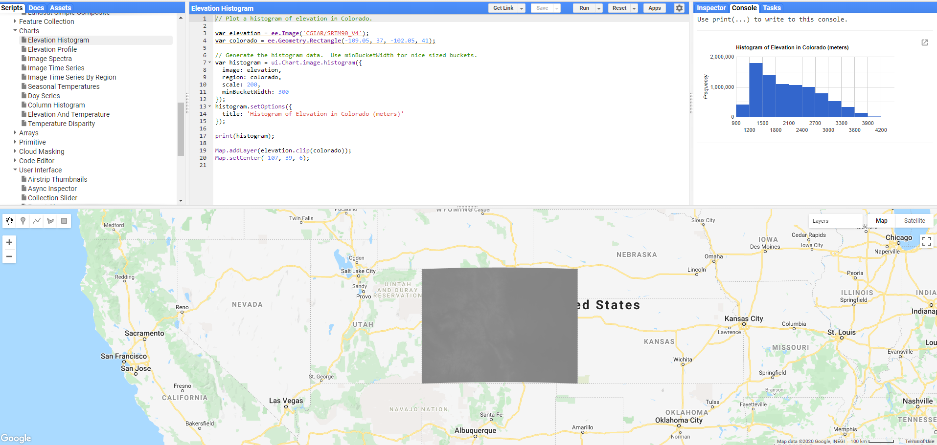
Code Editor
Code Editor is a JavaScript based (browser based) command-line Interface accessible at:
https://code.earthengine.google.com/

